Slide 1

Team Name : Blue Pill
Team Leader Name : TUMATI SUHAS PRANAY
Problem Statement : AI for Retail, Commerce & Market Intelligence

Slide 2

Brief about the Idea:
BluePill AI
AI Business Consultant for Retail & Marketplaces
Value Proposition
Driving data-backed retail decisions with 20–30% inventory reduction, 5–10% margin improvement, and 5x faster seller onboarding through a unified AI intelligence platform.
What the Solution Does ?
A unified AI-driven analytics platform for retailers, D2C brands, and marketplaces
Ingests sales history, festival calendars, competitor pricing, customer reviews, real-time news, and seller documents
Applies forecasting, machine learning, and generative AI to deliver actionable, explainable, human-reviewed/AI-verified business recommendations
Target Market
Large retail enterprises,
E-commerce and D2C platforms,
Marketplace operations & category management teams (ONDC-like ecosystems)

Slide 3
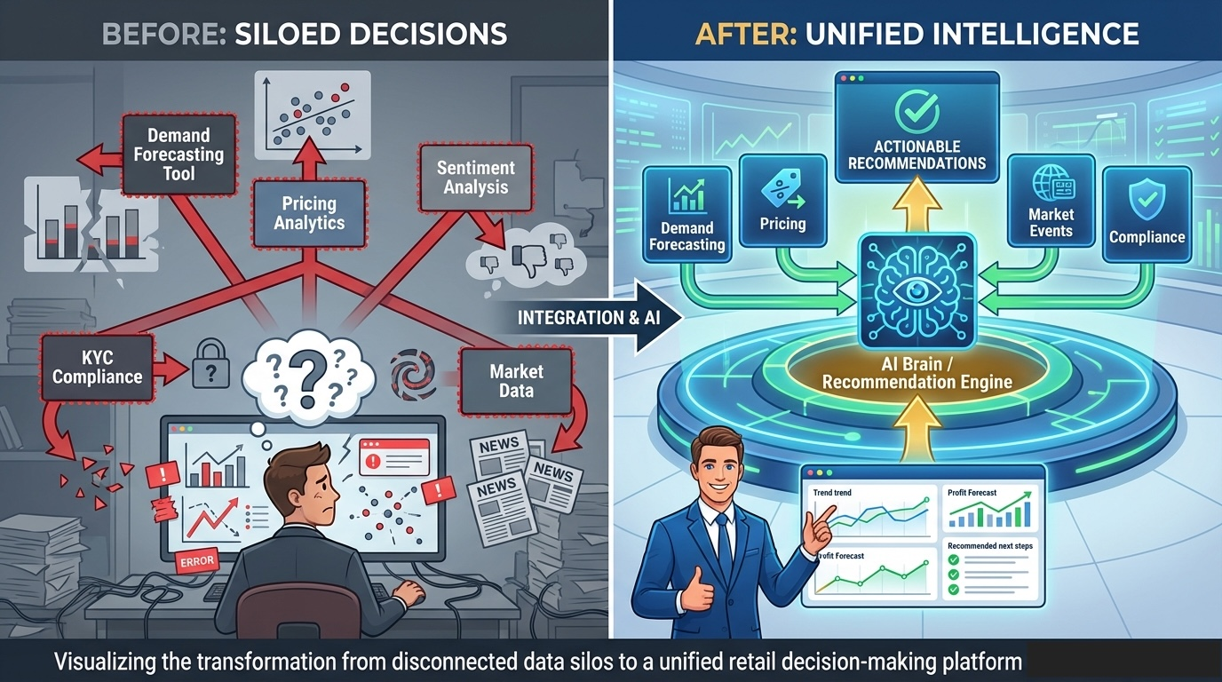
1. The Problem with Existing Solutions
Most tools solve one problem in isolation Forecasting → Demand only | Pricing → Price only | Sentiment → Reviews only | KYC → Compliance only
BluePill AI unifies all of them into a single decision intelligence layer
2. How BluePill AI Solves It ?
Predicts demand - Sales history + festivals + weather
Optimizes pricing - Competitor intelligence & elasticity
Tracks market risks - Real-time news, trend analysis
Understands customers - AI-driven sentiment score
Accelerates onboarding - Automated KYC and compliance checks
All insights run in parallel, are AI-validated, and human-reviewed
3. USP (Why It’s Hard to Replicate?)
Unified Decision Engine: reasons across demand, price, sentiment, events & risk; Explainable AI: explains why, not just what; Bharat-Ready: built for festivals, ONDC-style marketplaces & noisy data; Production-Ready: powered by AWS AI (Forecast, Bedrock, Comprehend)

Slide 4
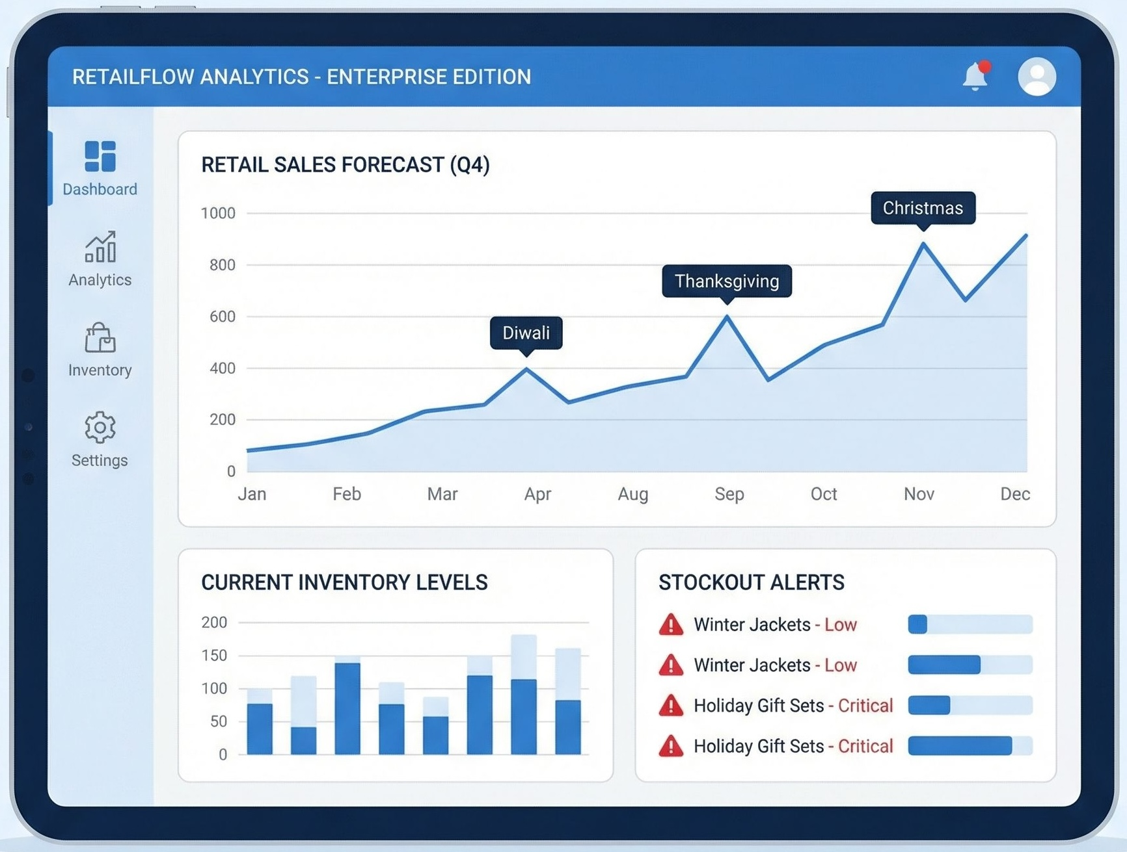
List of features offered by the solution
1. AI Demand Forecasting & Inventory Intelligence
Why AI is needed
Festival-driven demand, weather impact, and promotions create non-linear patterns that rule-based forecasting cannot capture.
How AI is used
Machine learning models learn seasonality, trends, and external signals (festivals, weather, campaigns) to generate SKU-level demand forecasts.
Models continuously improve using historical accuracy feedback.
Responsible & usable design
Forecast confidence bands shown clearly.
Human users can review, override, or simulate scenarios before action.

Slide 5
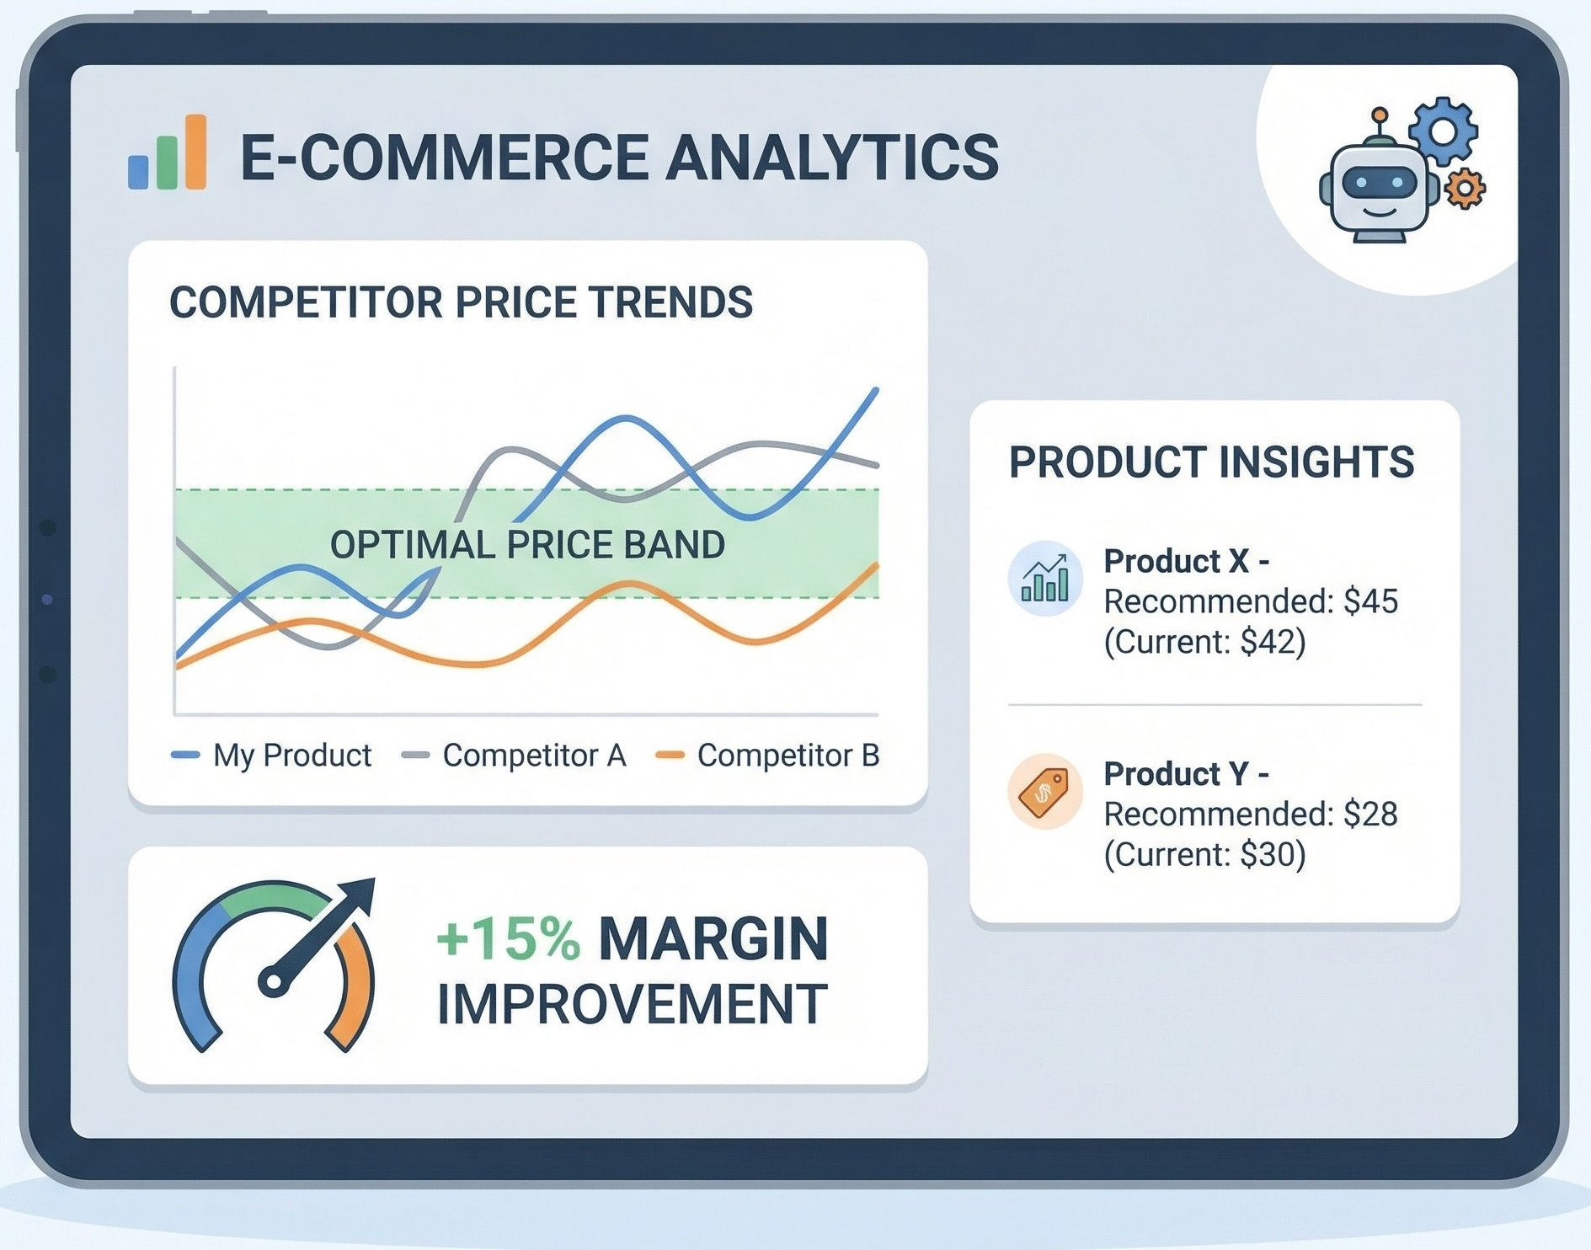
List of features offered by the solution
2. Dynamic Pricing & Competitive Intelligence
Why AI is needed
Competitor prices, demand elasticity, and timing effects change dynamically and cannot be handled by static rules.
How AI is used
AI models analyse historical sales vs price behaviour to learn price elasticity.
Recommends optimal price ranges and markdown timing based on predicted impact.
Responsible & usable design
Recommendations are explainable (“price reduced due to competitor move”).
Final pricing decisions remain with humans.

Slide 6
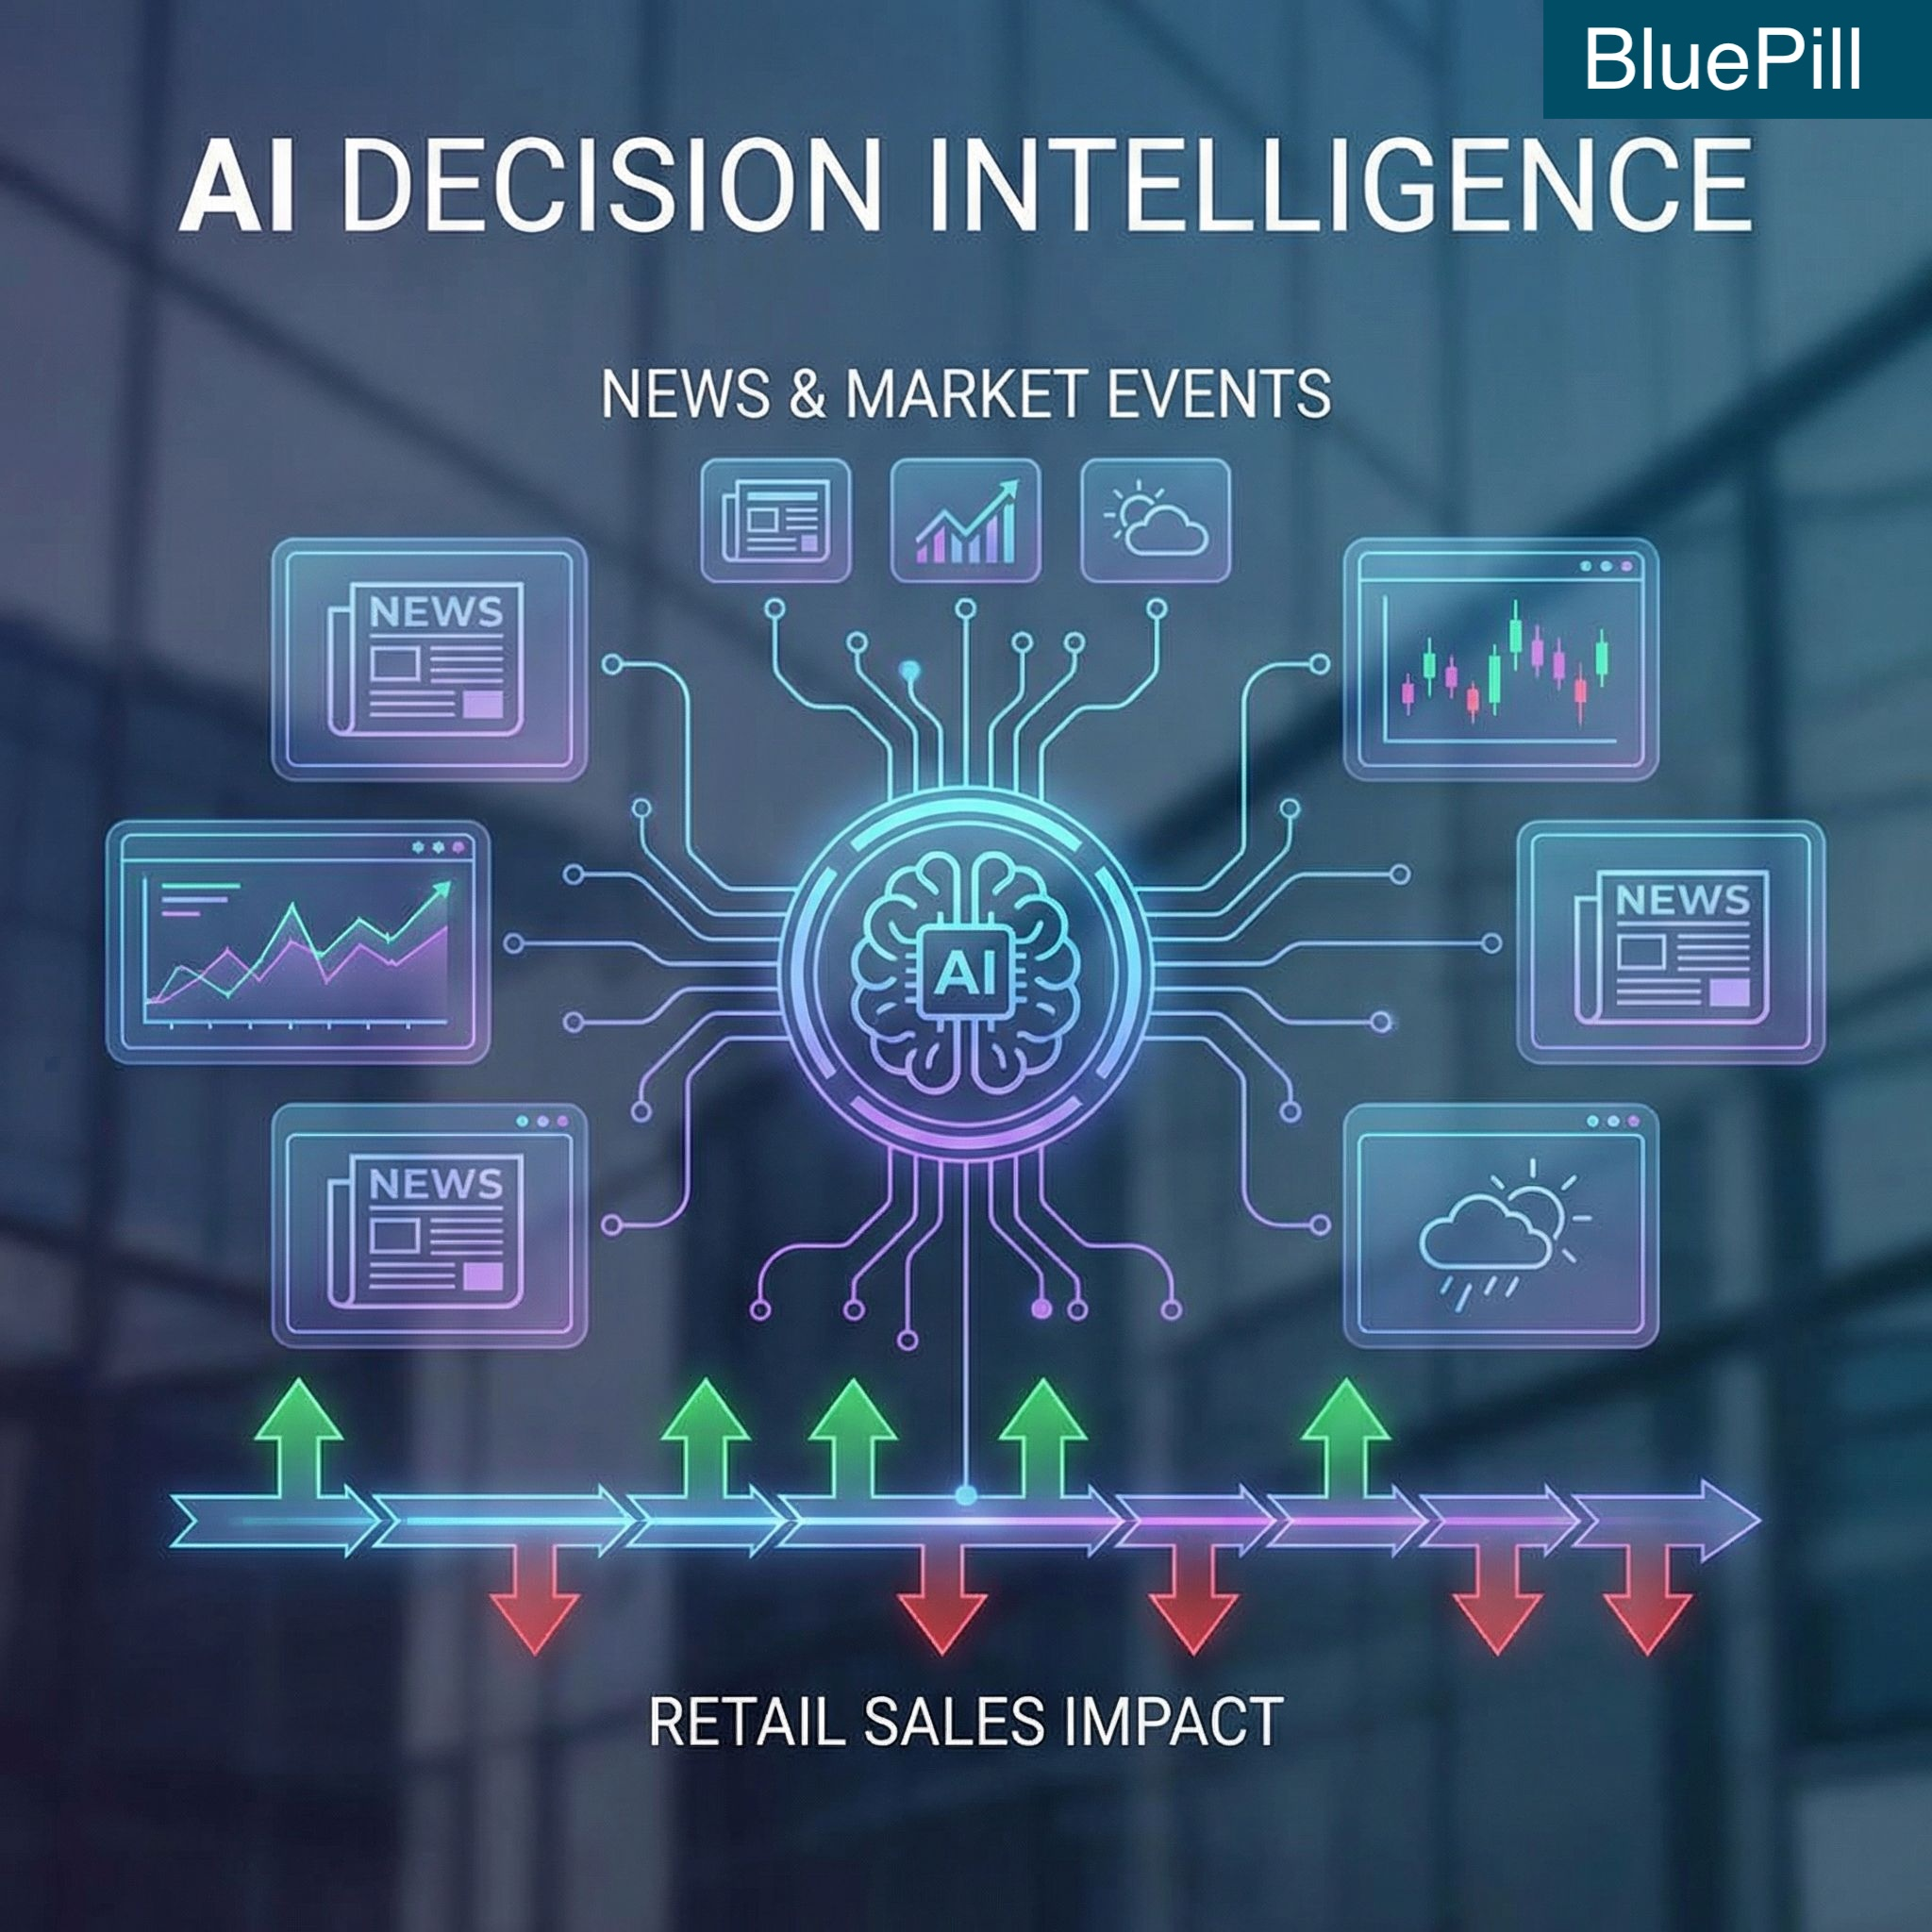
List of features offered by the solution
3. Market Events & Risk Intelligence (News + Trends)
Why AI is needed
Unstructured news, policy updates, and events cannot be reliably processed using rule-based logic.
How AI is used
Generative AI and NLP extract relevant events from real-time news.
AI classifies impact (positive/negative/neutral) and severity on sales.
Responsible & usable design
Each insight is backed with source references.
AI highlights risks; humans decide responses.

Slide 7
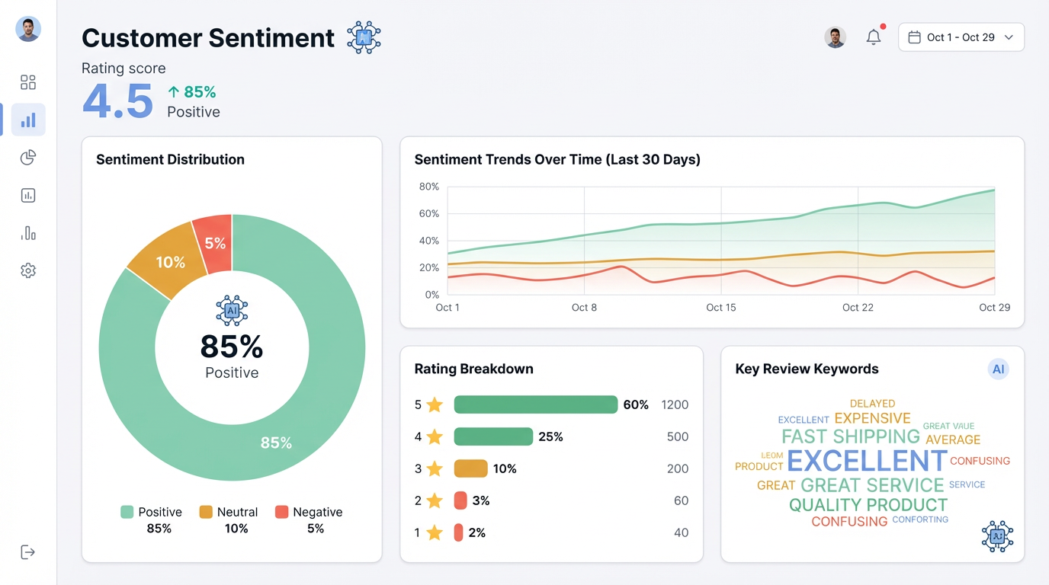
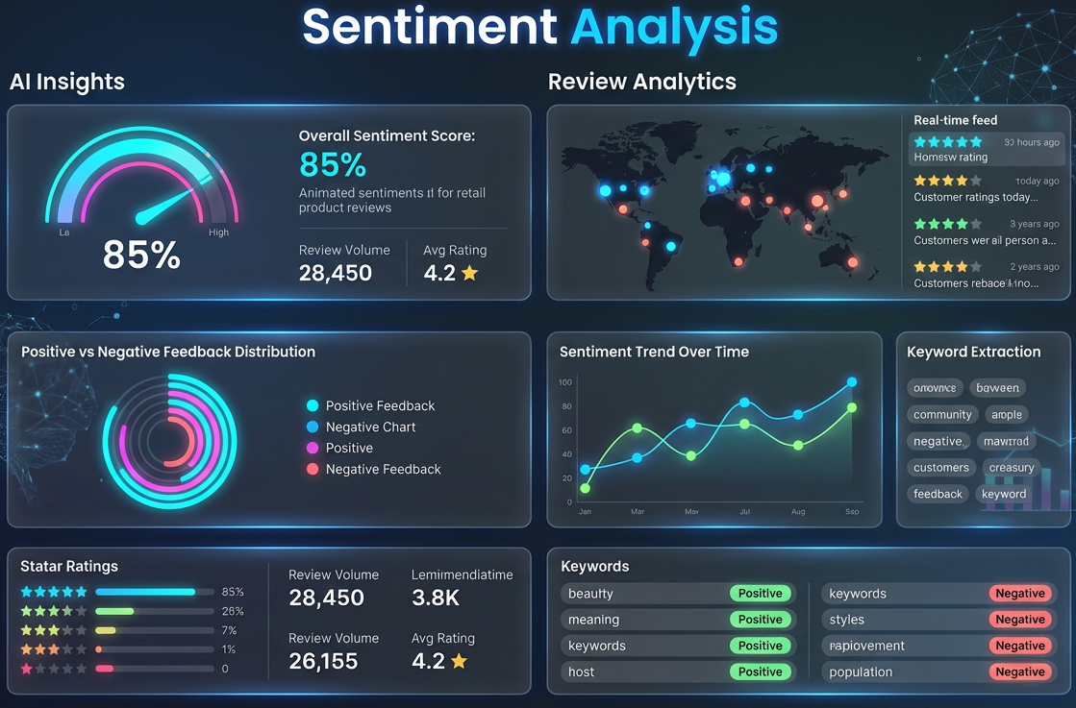
List of features offered by the solution
4. Customer Sentiment & Experience Insights
Why AI is needed
Customer feedback is unstructured, multilingual, and subjective — rules fail at scale.
How AI is used
NLP models analyse reviews to detect sentiment, themes, and emerging issues. Aggregates insights across platforms for trend detection.
Responsible & usable design
Transparent sentiment breakdowns. Used for product improvement, not automated decisions.

Slide 8
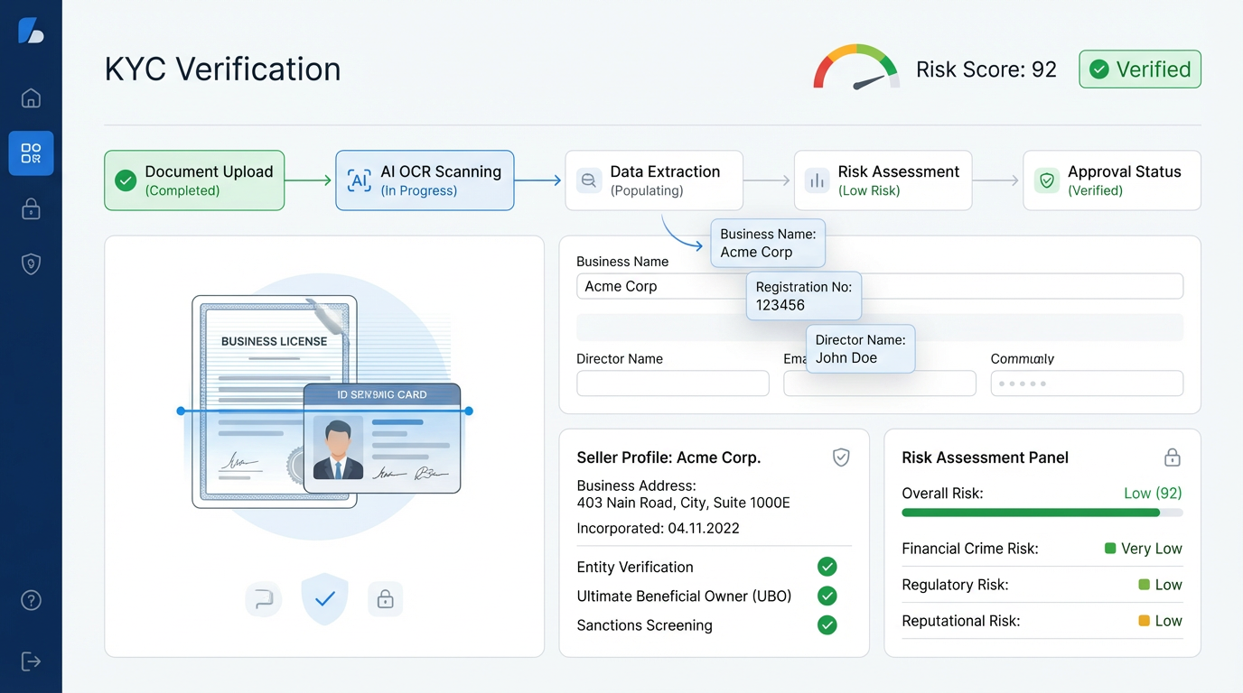
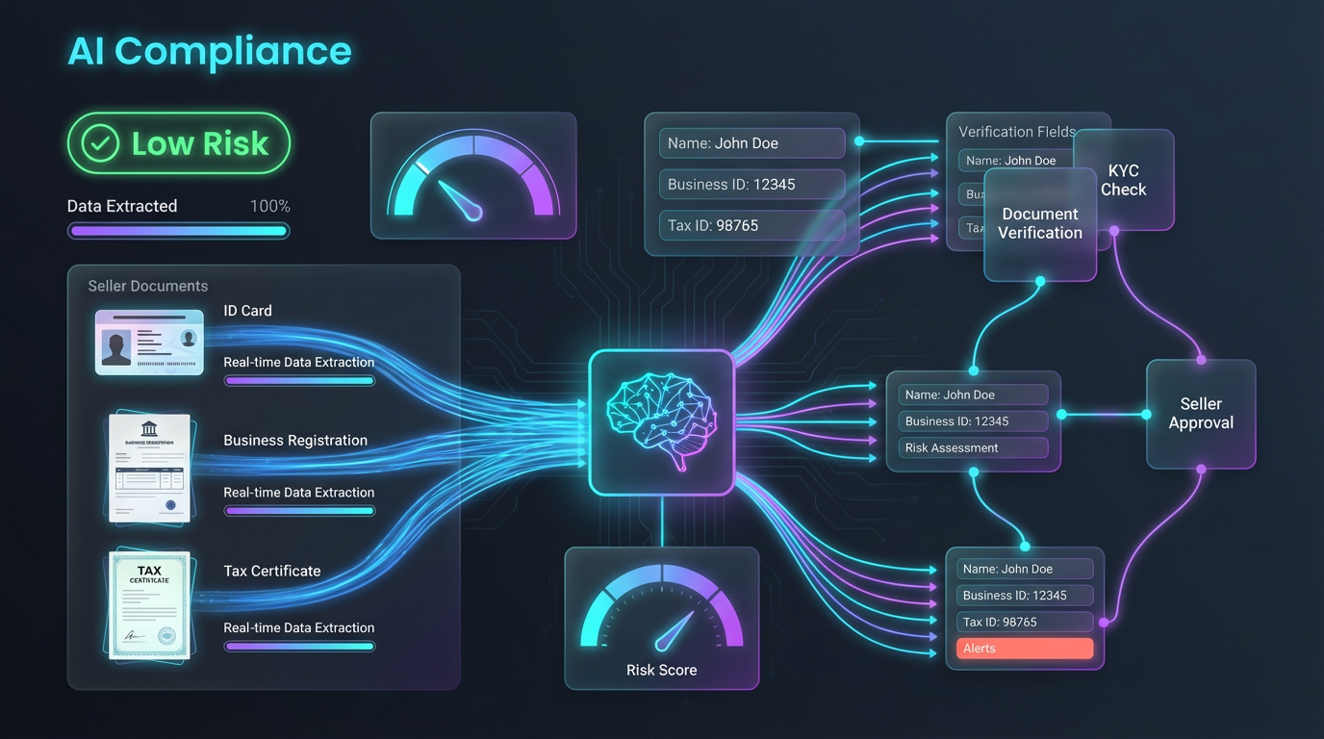
List of features offered by the solution
5. Seller KYC & Compliance Automation
Why AI is needed
Manual KYC review is slow, inconsistent, and error-prone; rule-based checks miss hidden risks.
How AI is used
AI extracts data from documents using OCR + NLP. ML models assess risk patterns across seller history and documents.
Responsible & usable design
Human review required for final approval.
Full audit trail maintained for compliance and trust.

Slide 9
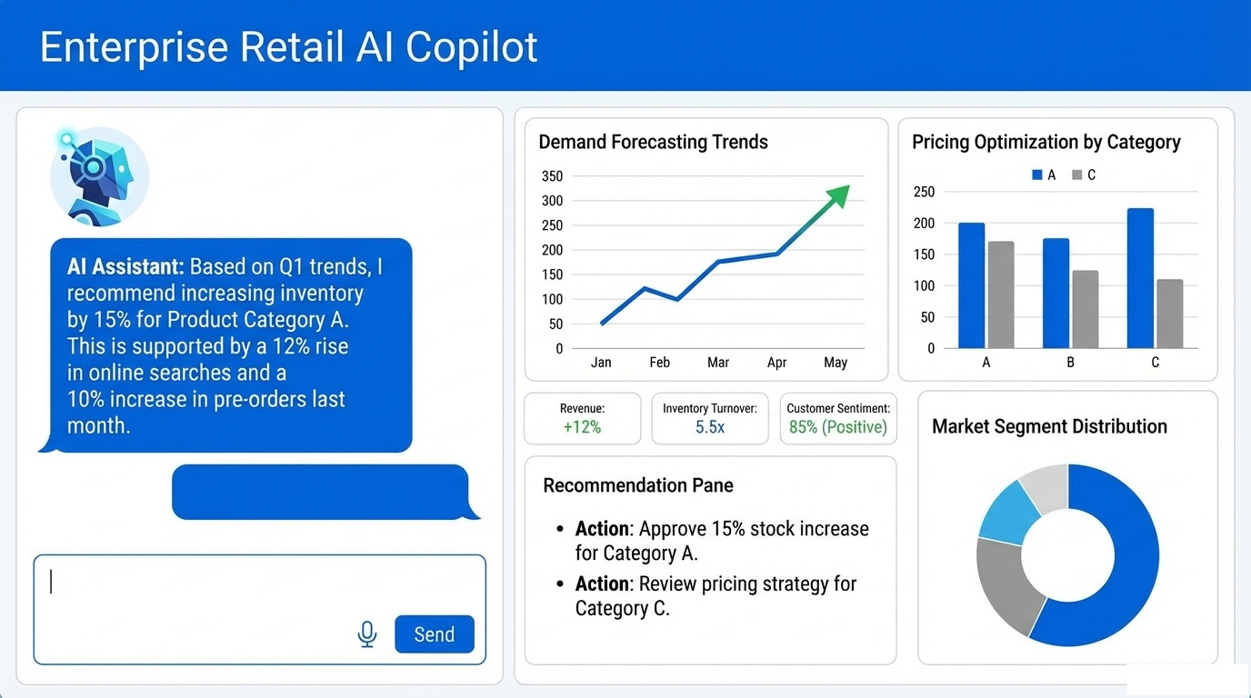
List of features offered by the solution
6. AI Business Copilot (Explainable AI)
Why AI is needed
Business users need reasoning and explanations, not static dashboards.
How AI is used
Generative AI explains recommendations, answers “why” and “what-if” questions.
Connects insights across forecasting, pricing, sentiment, and risk.
Responsible & usable design
AI does not take actions autonomously.
Designed as a decision-support assistant, not a replacement.

Slide 10
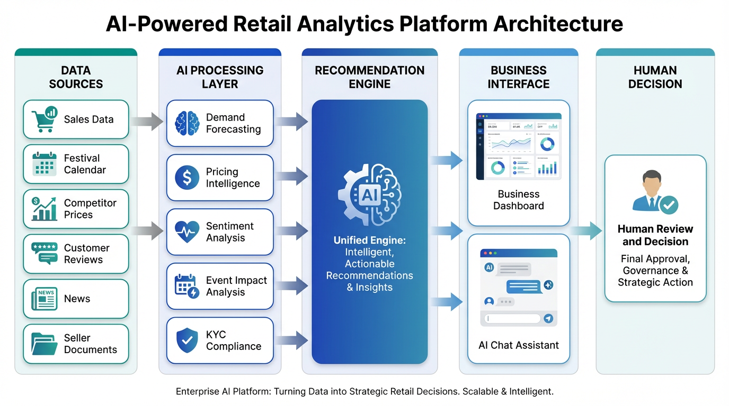
Process flow diagram or Use-case diagram
All AI analyses run in parallel and converge into a unified, explainable recommendation reviewed by humans before action.

Slide 11
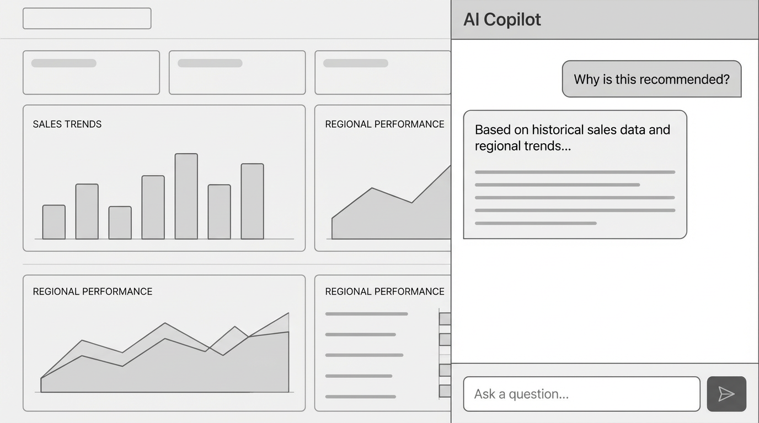
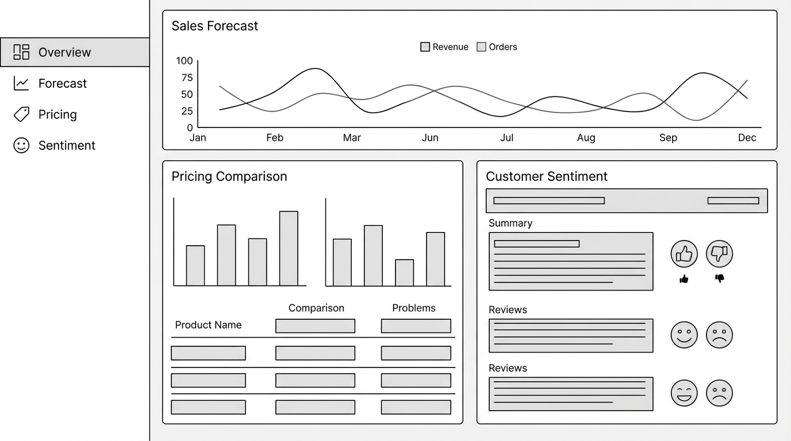
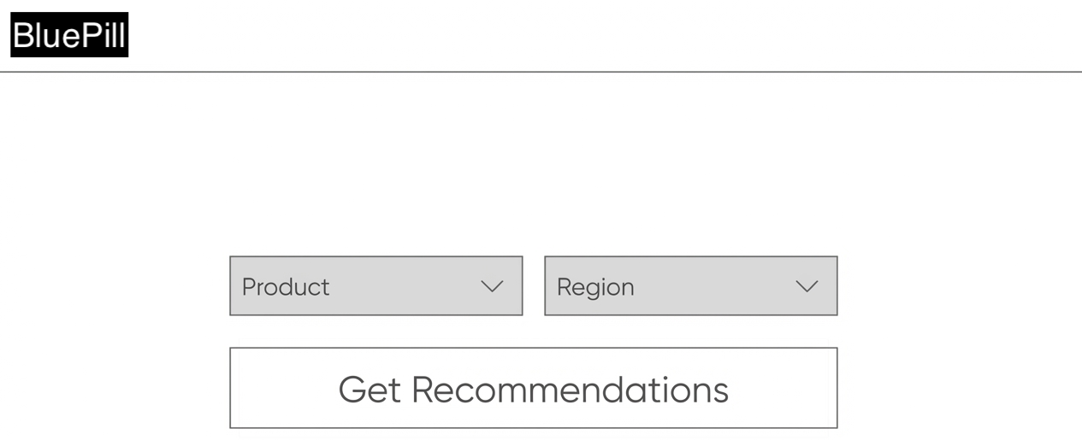
Wireframes/Mock diagrams of the proposed solution

Slide 12
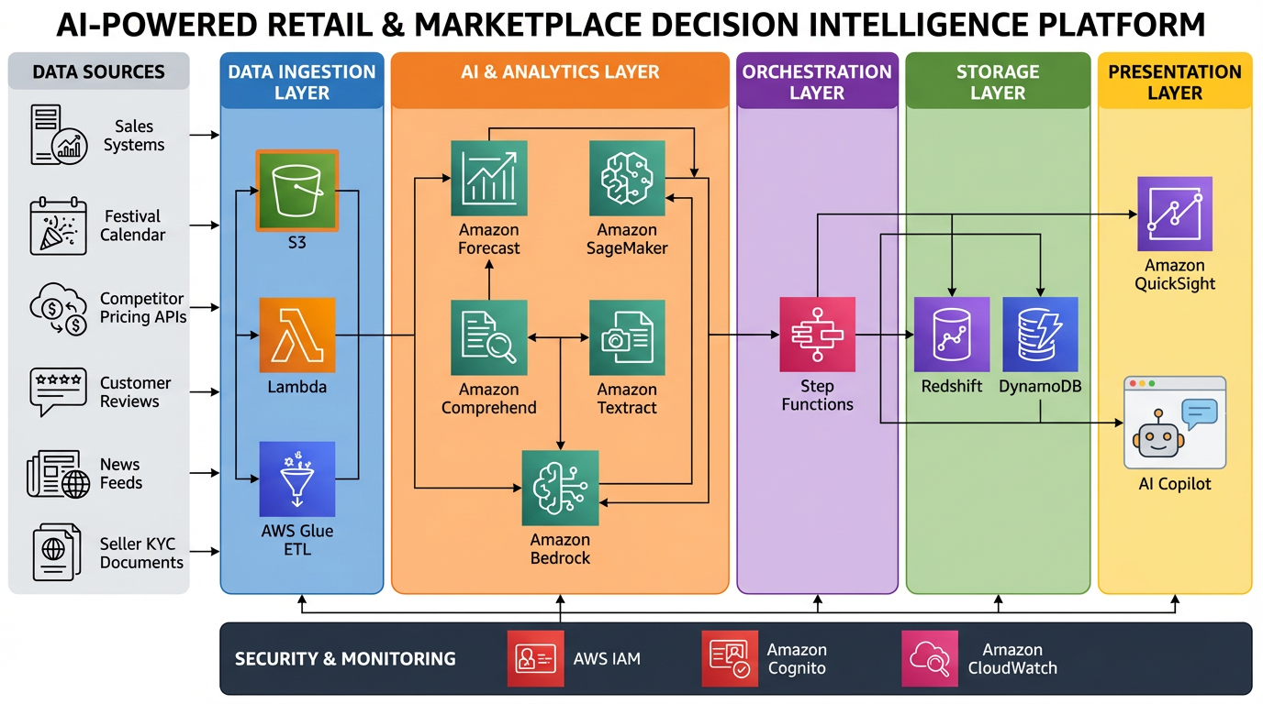
Architecture diagram of the proposed solution:
Built using fully managed AWS AI services

Slide 13
Technologies to be used in the solution:
Cloud Platform
Amazon Web Services (AWS) – scalable, secure, managed cloud infrastructure
Data Ingestion & Processing
Amazon S3 – centralized data lake for sales, pricing, reviews, news, and documents
AWS Lambda – serverless ingestion and event-driven processing
AWS Glue – data transformation, schema management, and ETL pipelines
AI & Machine Learning
Amazon Forecast – demand forecasting with seasonality and festival awareness
Amazon SageMaker – pricing optimization, elasticity modeling, risk scoring models
Amazon Comprehend – customer sentiment analysis and text classification
Amazon Textract – OCR and data extraction from KYC and compliance documents
Amazon Bedrock – generative AI for insight summarization, reasoning, and AI copilot chat
Workflow Orchestration
AWS Step Functions – coordinating multi-step AI workflows and parallel execution

Slide 14
Technologies to be used in the solution:
Data Storage & Analytics
Amazon Redshift – analytical queries and aggregated insights
Amazon DynamoDB – low-latency storage for recommendations and metadata
Visualization & User Experience
Amazon QuickSight – interactive dashboards for forecasts, pricing, and trends
Web UI (React / AWS Amplify) – business-facing application interface
AI Copilot Interface – chat-based assistant powered by Amazon Bedrock
Security, Identity & Monitoring
AWS IAM – secure access control and service permissions
Amazon Cognito – user authentication and role-based access
Amazon CloudWatch – logging, monitoring, and system health tracking
Built entirely on managed AWS AI services — scalable, explainable & production-ready.
Directly addresses AI for Retail, Commerce & Market Intelligence by enabling data-driven decisions across inventory, pricing, customer experience, and marketplace operations.

Slide 15
Estimated implementation cost:
Business ROI Justification
20–30% inventory cost reduction
5–10% margin improvement
5× faster seller onboarding
Operational savings significantly outweigh platform costs
Low-cost to pilot, high-impact to scale — designed for real-world adoption.
Prototype / Hackathon Phase (Using AWS Credits)
Cost: Covered under AWS promotional / hackathon credits
Scope:
Sample datasets (limited SKUs, regions)
On-demand model training
Low-volume inference and dashboards
No upfront infrastructure investment required
Pilot Deployment (Small–Medium Retailer / Marketplace)
Component | Estimated Monthly Cost
Data storage (Amazon S3) | Low
Forecasting & ML (Amazon Forecast, SageMaker – on-demand) | Medium
NLP & GenAI (Comprehend, Bedrock – usage based) | Medium
Dashboards & UI (QuickSight, Web App) | Low
Security & Monitoring | Low

Slide 16
Add as per the requirements for the hackathon:
GIT Repo link
https://github.com/suhastumati/AI-for-Retail-Commerce-Market-Intelligence

Slide 17


